Slide 1

INSTITUTE: UIE (AIT-CSE)
Computer Networks CST- 335
MOBILE IP
DNS and email
By : Dr.Monica Luthra(E9836)
DISCOVER . LEARN . EMPOWER

Slide 2

Course Objectives
CO Number | Title | Level
CO1 | To bring together several keys to Computer Network Design and Architecture. | Remember
CO2 | To recognize the key concepts of Internetworking. | Understand
CO3 | To prepare a sample Network via Simulation. | Understand

Slide 3
Course Objectives
CO Number | Title
CO1 | Describe the important networking concepts
CO2 | Understand concept of network reference models and protocols
CO3 | Apply the concepts of routing algorithms on various networks
CO4 | Identify mechanism to handle traffic and control on congestion
CO5 | Identify and understand connection establishment techniques and features

Slide 4
Table of Contents
MOBILE IP
DNS and email

Slide 5
DNS
The Domain Name System (DNS) is the phonebook of the Internet. Humans access information online through domain names, like nytimes.com or espn.com. Web browsers interact through Internet Protocol (IP) addresses. DNS translates domain names to IP addresses so browsers can load Internet resources.
Domain Name Server (DNS) is a standard protocol that helps Internet users discover websites using human readable addresses. Like a phonebook which lets you look up the name of a person and discover their number, DNS lets you type the address of a website and automatically discover the Internet Protocol (IP) address for that website.
Without DNS, the Internet would collapse - it would be impossible for people and machines to access Internet servers via the friendly URLs they have come to know.
For example, the domain name www.ns1.com you are viewing now, translates to the IP address 104.20.48.182 (in the old IPv4 format) or 2002:6814:30b6:0:0:0:0:0 (in the newer IPv6 format).

Slide 6
DNS
How does DNS work?
The process of DNS resolution involves converting a hostname (such as www.example.com) into a computer-friendly IP address (such as 192.168.1.1). An IP address is given to each device on the Internet, and that address is necessary to find the appropriate Internet device - like a street address is used to find a particular home. When a user wants to load a webpage, a translation must occur between what a user types into their web browser (example.com) and the machine-friendly address necessary to locate the example.com webpage.
In order to understand the process behind the DNS resolution, it’s important to learn about the different hardware components a DNS query must pass between. For the web browser, the DNS lookup occurs "behind the scenes" and requires no interaction from the user’s computer apart from the initial request.

Slide 7
EMAIL
Electronic Mail (e-mail) is one of most widely used services of Internet. This service allows an Internet user to send a message in formatted manner (mail) to the other Internet user in any part of world. Message in mail not only contain text, but it also contains images, audio and videos data. The person who is sending mail is called sender and person who receives mail is called recipient. It is just like postal mail service.
Components of E-Mail System : The basic components of an email system are : User Agent (UA), Message Transfer Agent (MTA), Mail Box, and Spool file. These are explained as following below.
User Agent (UA) : The UA is normally a program which is used to send and receive mail. Sometimes, it is called as mail reader. It accepts variety of commands for composing, receiving and replying to messages as well as for manipulation of the mailboxes.

Slide 8
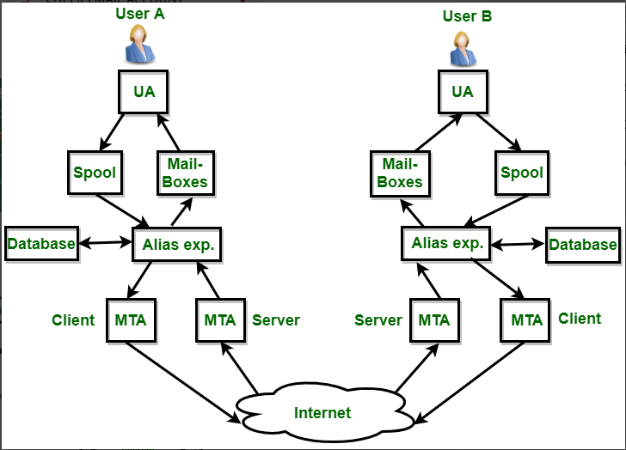
Message Transfer Agent (MTA) : MTA is actually responsible for transfer of mail from one system to another. To send a mail, a system must have client MTA and system MTA. It transfer mail to mailboxes of recipients if they are connected in the same machine. It delivers mail to peer MTA if destination mailbox is in another machine. The delivery from one MTA to another MTA is done by Simple Mail Transfer Protocol
Image Source : https://www.geeksforgeeks.org/introduction-to-electronic-mail/

Slide 9
FTP
FTP stands for File transfer protocol.
FTP is a standard internet protocol provided by TCP/IP used for transmitting the files from one host to another.
It is mainly used for transferring the web page files from their creator to the computer that acts as a server for other computers on the internet.
It is also used for downloading the files to computer from other servers.

Slide 10
Why FTP?
Although transferring files from one system to another is very simple and straightforward, but sometimes it can cause problems. For example, two systems may have different file conventions. Two systems may have different ways to represent text and data. Two systems may have different directory structures. FTP protocol overcomes these problems by establishing two connections between hosts. One connection is used for data transfer, and another connection is used for the control connection.

Slide 11
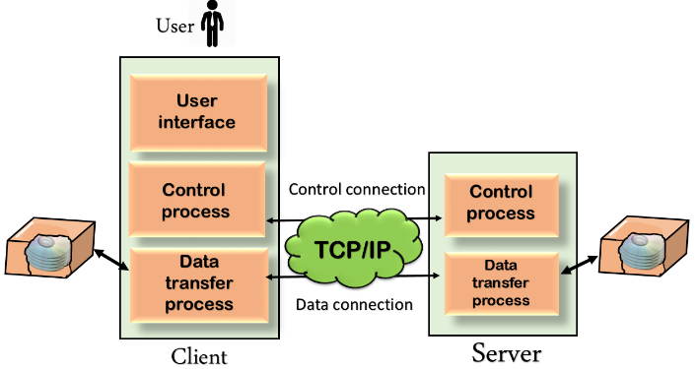
Mechanism of FTP
The above figure shows the basic model of the FTP. The FTP client has three components: the user interface, control process, and data transfer process. The server has two components: the server control process and the server data transfer process.
Control Connection: The control connection uses very simple rules for communication. Through control connection, we can transfer a line of command or line of response at a time. The control connection is made between the control processes. The control connection remains connected during the entire interactive FTP session.
Data Connection: The Data Connection uses very complex rules as data types may vary. The data connection is made between data transfer processes. The data connection opens when a command comes for transferring the files and closes when the file is transferred.
Image Source : https://www.javatpoint.com/computer-network-ftp/

Slide 12
Mobile IP
Mobile IP is a communication protocol (created by extending Internet Protocol, IP) that allows the users to move from one network to another with the same IP address. It ensures that the communication will continue without user’s sessions or connections being dropped. Mobile Node (MN): It is the hand-held communication device that the user caries e.g. Cell phone.
Home Network: It is a network to which the mobile node originally belongs to as per its assigned IP address (home address).
Home Agent (HA): It is a router in home network to which the mobile node was originally connected
Home Address: It is the permanent IP address assigned to the mobile node (within its home network).
Foreign Network: It is the current network to which the mobile node is visiting (away from its home network).
Foreign Agent (FA): It is a router in foreign network to which mobile node is currently connected. The packets from the home agent are sent to the foreign agent which delivers it to the mobile node.
Correspondent Node (CN): It is a device on the internet communicating to the mobile node.
Care of Address (COA): It is the temporary address used by a mobile node while it is moving away from its home network.

Slide 13
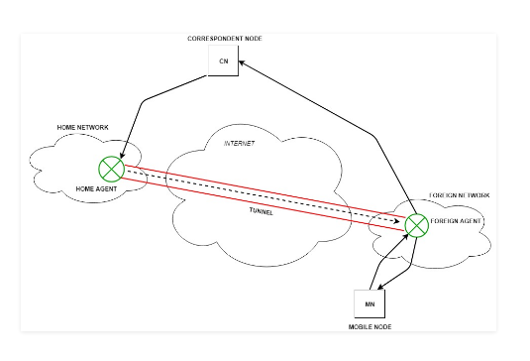
Mobile IP
Working: Correspondent node sends the data to the mobile node. Data packets contains correspondent node’s address (Source) and home address (Destination). Packets reaches to the home agent. But now mobile node is not in the home network, it has moved into the foreign network. Foreign agent sends the care-of-address to the home agent to which all the packets should be sent. Now, a tunnel will be established between the home agent and the foreign agent by the process of tunneling.
Image Source : https://www.geeksforgeeks.org/mobile-internet-protocol-or-mobile-ip/

Slide 14

References
https://en.wikipedia.org/wiki/Leaky_bucket
https://www.geeksforgeeks.org/leaky-bucket-algorithm/
https://en.wikipedia.org/wiki/Token_bucket
https://www.ques10.com/p/31441/what-is-traffic-shaping-explain-leaky-bucket-algor/

Slide 15
THANK YOU
For queries
Email: monica.e9836@cumail.in

